Slide 1



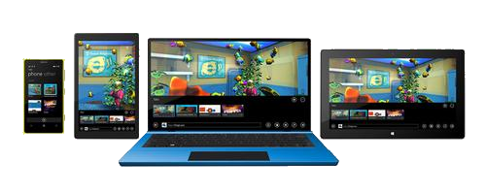
Windows Universal Controls

Slide 2

Table of Contents
XAML Controls
Text controls
Buttons
List controls
GroupBox and Expander
Menus
Toolbars

Slide 3

Table of Contents
Other controls
Slider and Scroll controls
ProgressBar
ToolTip
Custom User Controls

Slide 4
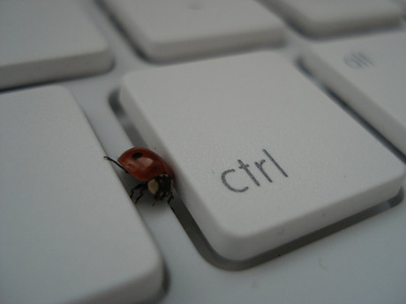
XAML Controls

Slide 5
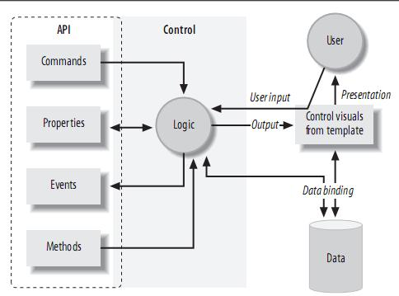
XAML Control
XAML Controls are typically not directly responsible for their own appearance
XAML Controls are all about behavior
They refer to templates to provide their visuals

Slide 6
XAML Controls (2)
Controls may use commands to represent supported operations
Controls offer properties to provide a means of modifying either behavior
Controls raise events when something important happens
XAML provides a range of built-in controls
Most of these correspond to standard Windows control types

Slide 7

Text Controls

Slide 8
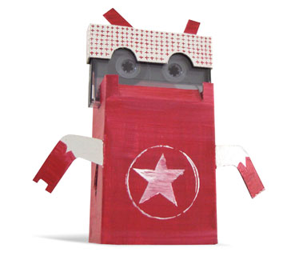
TextBoxes

Slide 9
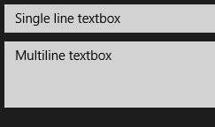
TextBox
TextBox a control that can be used to display single-format, multi-line text
By setting AcceptsReturn to true, it can edit multiple lines
ScrollViewer.VerticalScrollBarVisibility – attached property that gets/sets scrollbar visibility
PasswordBox
The users sees only the "*" symbol
<TextBox Margin="5" VerticalAlignment="Center"
Text="Single line textbox" />
<TextBox VerticalAlignment="Center“ Margin="5“
Height="120“ AcceptsReturn="True“
ScrollViewer.VerticalScrollBarVisibility="Visible"
Text="Multiline textbox" />

Slide 10

TextBlock
TextBlock a lightweight control for displaying small amounts of text
Name - identifying name of the object
TextWrapping
<TextBlock Name="TextBlock"
VerticalAlignment="Center"
HorizontalAlignment="Center"
FontSize="35"
FontWeight="Bold"
TextWrapping="Wrap"
Text="I am a TextBlock" />

Slide 11
RichEditBox
RichEditBox supports all of the commands defined by the EditingCommands class
Recognize the RTF format
Paste formatted text from Internet Explorer and Word
Both TextBox and RichTextBox offer built-in spellchecking
IsSpellCheckEnabled property

Slide 12
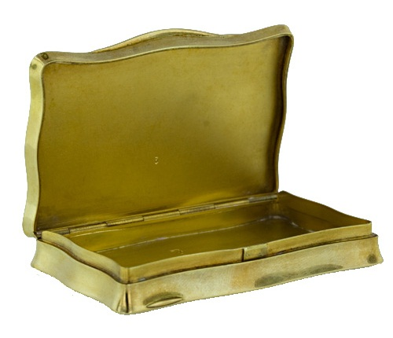
Text Boxes
Live Demo

Slide 13
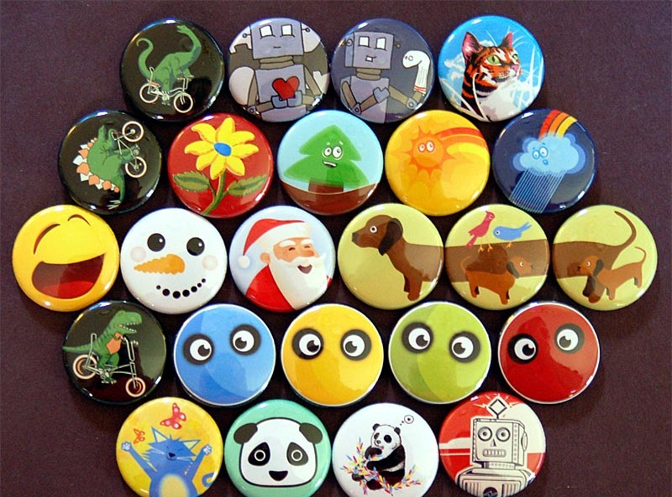
Buttons

Slide 14
Regular Button
Windows 8 Store supports many types of buttons
Button – the regular button
Click event handler
Content property
Command property for command binding
<Button Content="Click me"
Click="OnButtonClick" />
<Button Content="Click me with command"
Command={Binding Click}" />

Slide 15
ToggleButton
Holds its state when it is clicked
IsChecked property
IsThreeState property
Gives IsChecked three possible values true, false, or null
ToggleButton defines a separate event for each value of IsChecked
Checked for true
Unchecked for false
Indeterminate for null

Slide 16

ToggleButton
Live Demo

Slide 17


CheckButton and RadioButton
They derive from ButtonBase indirectly via the ToggleButton class
IsChecked property, indicating whether the user has checked the button
CheckBox is nothing more than a ToggleButton with a different appearance
Radio buttons are normally used in groups in which only one button may be selected at a time

Slide 18
RadioButton - Example
Grouping radio buttons by name
<StackPanel>
<RadioButton GroupName="Fuel"
Margin="3">Petrol</RadioButton>
<RadioButton GroupName="Fuel"
Margin="3">Diesel</RadioButton>
<RadioButton GroupName="Induction"
Margin="3">Unforced</RadioButton>
<RadioButton GroupName="Induction"
Margin="3">Mechanical supercharger</RadioButton>
<RadioButton GroupName="Induction"
Margin="3">Turbocharger</RadioButton>
</StackPanel>

Slide 19

RadioButton
Live Demo

Slide 20
Other Buttons
HyperLinkButton
Navigates to a given URL through NavigateUri property
Click event handler
RepeatButton
Like the regular Button, but the mouse/finger can keep pressing
Click event handler – fires while the button is pressed
<HyperlinkButton Content="Go to http://minkov.it"
NavigateUri="http://minkov.it"/>
<RepeatButton Content="Click repeatedly"
Click="OnRepeatButtonClick"/>

Slide 21

List Controls

Slide 22

ComboBox
Enables users to select one item from a list
ComboBox defines two events
DropDownOpened
DropDownClosed
ComboBox can contain complex items

Slide 23
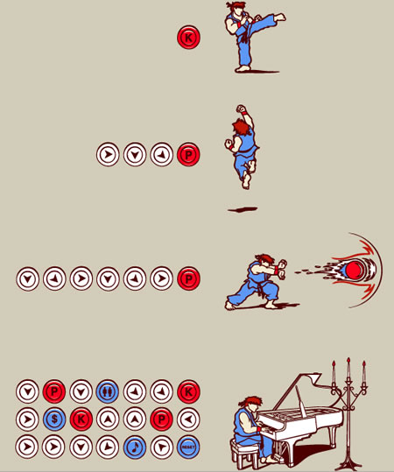
ComboBox
Live Demo

Slide 24
ListView & GridView
ListView - Control that displays a vertical list of data items
GridView - Control that displays a horizontal grid of data items
Both are ItemsControl, so they can contain a collection of items of any type
To populate:
add items to the Items collection
or set the ItemsSource property to a data source

Slide 25

ListView and GridView
Live Demo

Slide 26
The AppBar
The AppBar is just a toolbar for displaying application specific commands
Like settings and shortcut commands
Can be either TopAppbar or BottomAppBar
<Page.BottomAppBar>
<AppBar>
<StackPanel Orientation="Horizontal">
<Button Name="AddButton" Content="Add" />
<Button Name="EditButton" Content="Edit" />
<Button Name="RemoveButton" Content="Remove" />
</StackPanel>
</AppBar>
</Page.BottomAppBar>

Slide 27
AppBars
Live Demo

Slide 28
ContextMenu
Context Menu is actually a PopupMenu
It’s a simple container designed to hold Commands
Must be attached to a control using code behind
When a user right-taps on the control the context menu is displayed
PopupMenu popupMenu = new PopupMenu();
popupMenu.Commands.Add(new UICommand(…));
IUICommand chosenCommand = await popupMenu
.ShowForSelectionAsync(
GetElementRect((FrameworkElement)sender));

Slide 29

ContextMenu
Live Demo

Slide 30
Progress bars
Progress bars are used to show the user that the applications is doing something
The application has not hanged
Two types of Progress bars
ProgressBar and ProgressRing
<ProgressBar IsIndeterminate="True" Width="100"/>
<ProgressRing IsActive="True"/>

Slide 31
Progress Bars
Live Demo

Slide 32
XAML Overview
http://academy.telerik.com

Slide 33
Exercises
Write a program that show the simple window with one TextBox. Add text to the TextBox. If you select some text in the TextBox – display the current selection information.
Write a program with a Button and a TextBlock. The TextBlock should show the number of clicks on the button.
Write a program that shows a ComboBox with various elements added to its Items. For example – add text, ellipse and picture.

